Slide 1
Team Lead : Sejal C. Shirsath
Team Member : Chaitali R. Mahajan
Team Member : Mohini R. Tupe
Team Member: Prapti N. Yadav
College Name : PES’s Modern College of Engineering,Pune

Slide 2

EV ASSISTANT
Smart, Sustainable & User-Friendly Electric Vehicle Assistant

Slide 3

PROJECT OBJECTIVES
•Problem Statement
•Project Overview – Introduction
•End Users
•Wow Factor in Project
•Modelling/Block Diagram/Flow of Project
•Result/outcomes
•Conclusion
•Future Perspective

Slide 4

PROBLEM STATEMENT
Electric vehicle users face challenges in choosing suitable EVs, finding nearby charging stations, and estimating charging time. The EV Assistant provides EV recommendations, charging station search, charging time estimation, and FAQs to support efficient and hassle-free EV travel

Slide 5

PROJECT OVERVIEW - INTRODUCTION
Rapid EV adoption leads to challenges in vehicle selection, charging station availability, and charging time estimation, causing range anxiety.
EV Assistant is a Streamlit-based web application that helps users make informed EV-related decisions.
The system provides EV recommendations, nearby charging station search, and charging time estimation features.
By using data analytics and machine learning, the application promotes efficient and sustainable transportation.

Slide 6

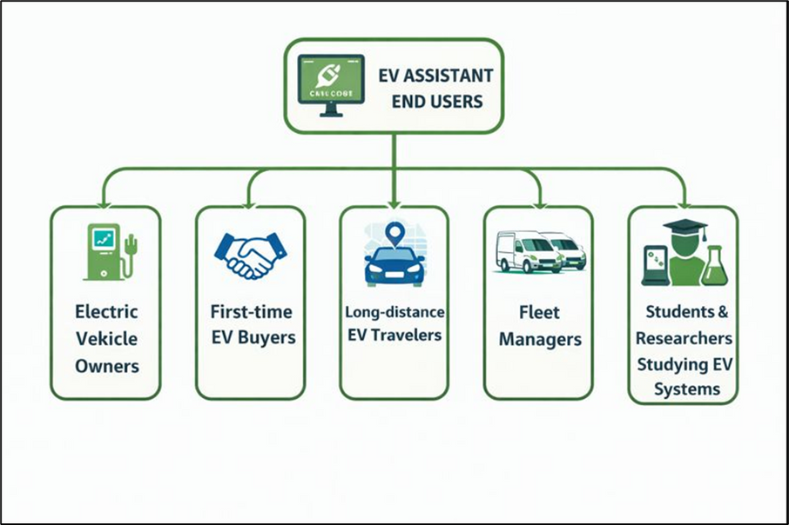
END USERS
Electric Vehicle owners
First-time EV buyers
Long-distance EV travelers
Fleet managers
Students & researchers studying EV systems

Slide 7
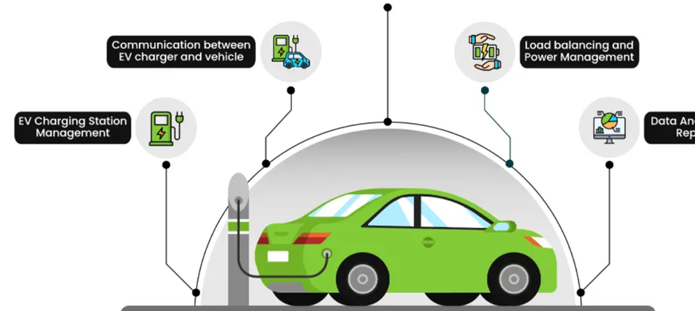
WOW FACTORS IN PROJECT
All-in-one EV Assistant on a single platform
EV Recommendation System using similarity analysis
Location-based charging station search with distance calculation
Charging Time Estimator for trip planning
Smart FAQ Chatbot for instant EV knowledge
Eco-friendly green UI theme
No complex setup – web-based & interactive

Slide 8
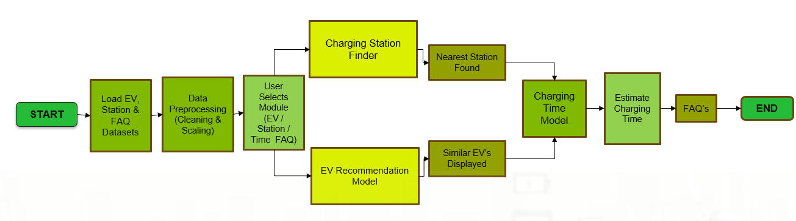
MODELLING/BLOCK DIAGRAM/FLOW OF PROJECT

Slide 9

TECHNOLOGY STACK
Frontend:
-Streamlit – Interactive web interface
- HTML & CSS – UI styling and green theme design
Backend / Logic:
- Python – Core application logic
- NumPy – Numerical computations
- Pandas – Data loading and preprocessing
Machine Learning
- Scikit-learn
- KNN (Nearest Neighbors) – EV recommendation & charging station search
- Distance calculations (Haversine metric)
Data Sources
- CSV files – EV car data & charging station data
- JSON files – EV FAQ dataset

Slide 10

RESULT/OUTCOMES
Successfully recommends similar EV models based on battery, range, and efficiency
Accurately identifies nearest charging stations using latitude-longitude data
Estimates charging time based on battery level and trip distance
Responds to common EV-related queries through FAQ chatbot
Provides a smooth, interactive, and visually appealing interface

Slide 11
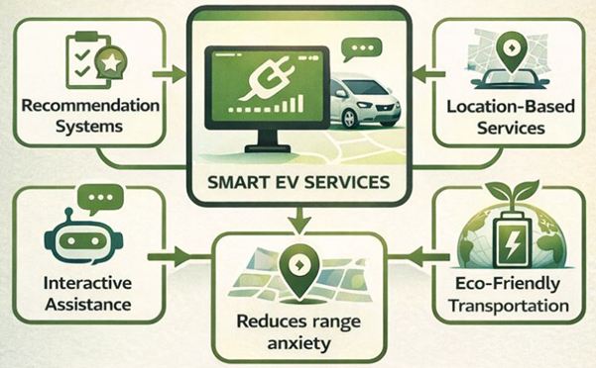
CONCLUSION:
The EV Assistant effectively addresses major challenges faced by EV users by combining recommendation systems, location-based services, and interactive assistance into a single platform. The system enhances user confidence, reduces range anxiety, and supports eco-friendly transportation. It serves as a practical solution for both existing and prospective EV users

Slide 12

FUTURE PERSPECTIVE
•Real-time charging station availability
• AI-based charging time prediction model
• Live route optimization with traffic data
• Charger type compatibility filtering
• Mobile application version
• Integration with Google Maps / OpenStreetMap APIs
• User profiles and trip history tracking

Slide 13
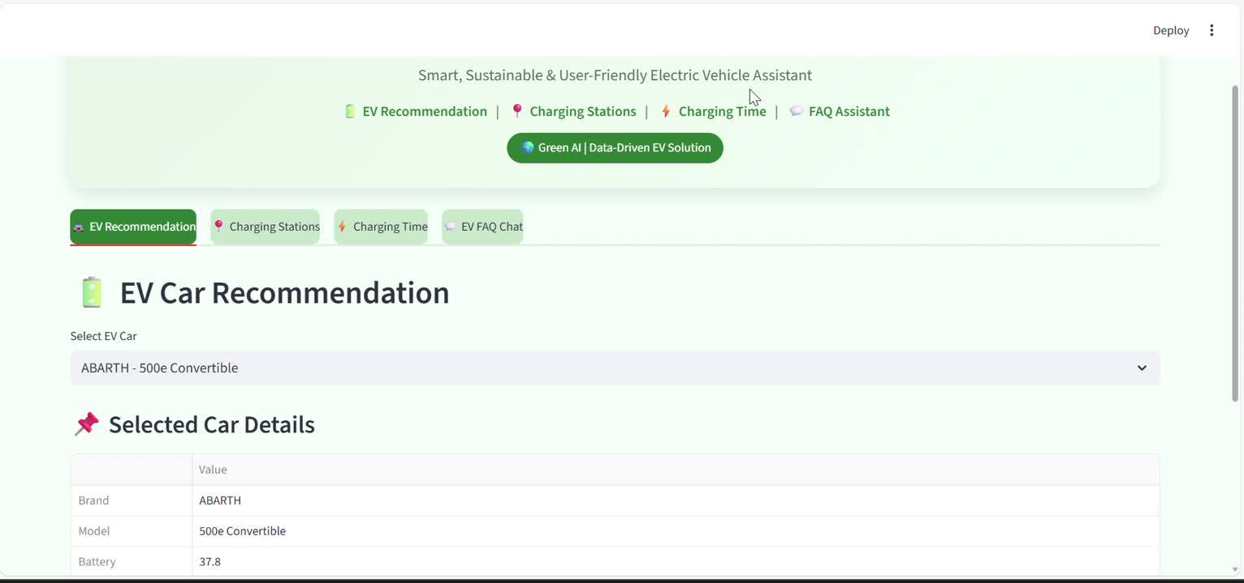
Thank You
https://drive.google.com/file/d/15oe9ekpiyRVroUWXwU9HWKRQU6bEIQjU/view?usp=sharing

Slide 14
Thank You

